Slide 1


Career path chatbot
A System for counselling
BY :
Fatmah Maid Alharthi 43708440
Hanan Atya Alzhrani 43706483
Bedoor Awad Alzaidi 43708107
Eman Saleh Alrubeie 43706129
3rd Bsc CS

Slide 2
Abstract
ChatBot is an automated answering system that simulate human conversation.
We aim to develop a chatbot that provides a career counseling by analyzing users’
questions and answering these questions as if it were answered by an expert or
a consultant.
This Chatbot helps users to know enough information about any career path
including skills needed, work environment, salary, etc, thus, the user decision about
their desired career path can be supported using the proposed chatbot..

Slide 3
Introduction
Chatbot is an automated conversational agent that interacts with users in a natural language based on artificial intelligence software. When a user inputs any content ,the chatbot processes it then generate an appropriate response.
There are multiple uses of chatbot including : Customer Support service, Weather , Personal Assistance.
Natural language processing (NLP) is the study of the ability to understand human language and process it in the same way that a human does

Slide 4
Problem Statemente
Many people need to consult someone about their career. The number of experts who can help is insufficient for the consulting requests, furthermore they cannot be available 24 /7.
Our chatbot will solve this problem by provide a great career consultation with an
immediate response, with privacy to the user and with 24/7 availability.

Slide 5
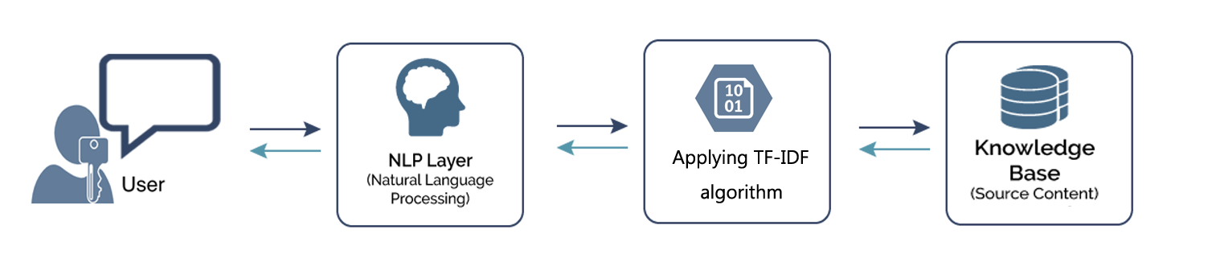
The chatbot works in 3 steps :
1- Reading in the source content
2-Reading data and Pre-processing the raw text:
3-Generating Response
Methodology
Chatbot framework

Slide 6
Methodology (cont'd)
1- Reading in the source content :
we feed the chatbot the content we want its to say ,by write the content to the chatbot.text file
that works as a knowledge base of the chatbot and the chatbot will use the file during
the processes.
We choosed four fields of computer science ,which are software engineering,cybersecurity, artificial intelligence and web development, to be the career paths that the chatbot will
consult about it . Information about these fields has been included in the source file. At the end, we will test the chatbot by asking it to give counseling about one of these fields
04

Slide 7
Methodology (cont'd)
2-Reading data and Pre-processing the raw text:
The Natural Language Toolkit (NLTK) is a library in Python programming language ,It contains
packages to make the machine understand human language and response to it.
Chatbot reads the user's input then Pre-processing the text using NLTK library to tokenization
the text.
Tokenization is a way to split text that can be paragraphs, sentences, or words .

Slide 8
Methodology (cont'd)
3-Generating Response
The chatbot creates a response for input question using the Tf-Idf approach.
Term Frequency Inverse Document Frequency (TF-IDF ): is approach to rescale
the frequency of words by how often they appear in all documents .
Tf-IDF can be implemented in scikit learn as:
We define a response function that will search the user’s statement for familiar words
and returns one of the multi possible responses. If there is no input matching any of
the keywords, it will return ”sorry! I can’t understand you”.

Slide 9
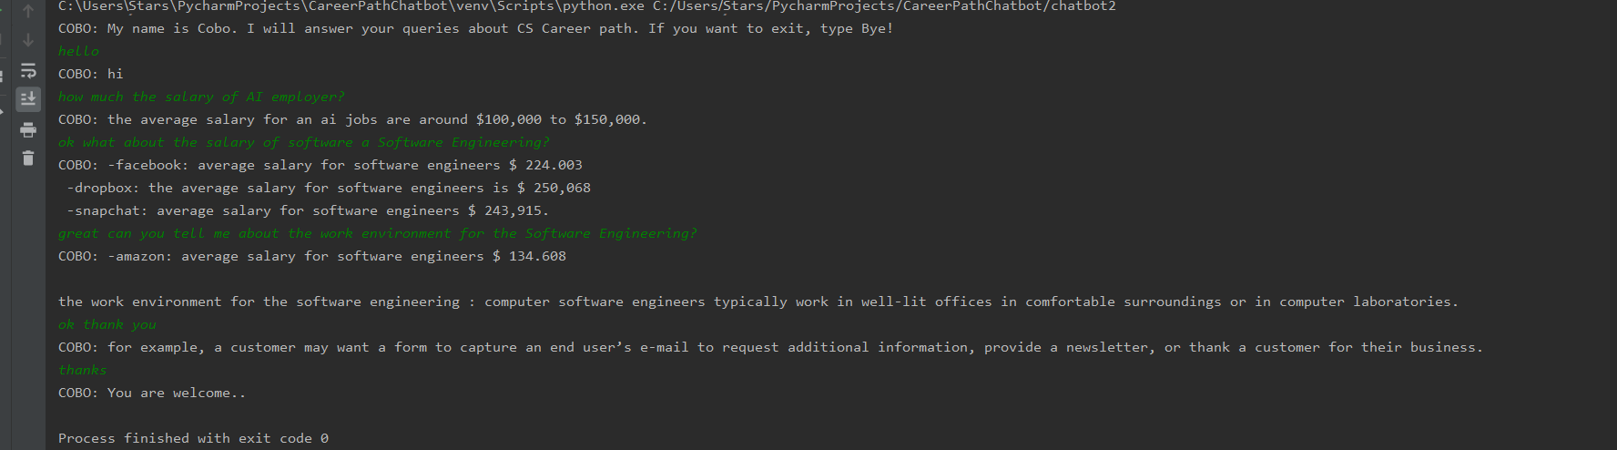
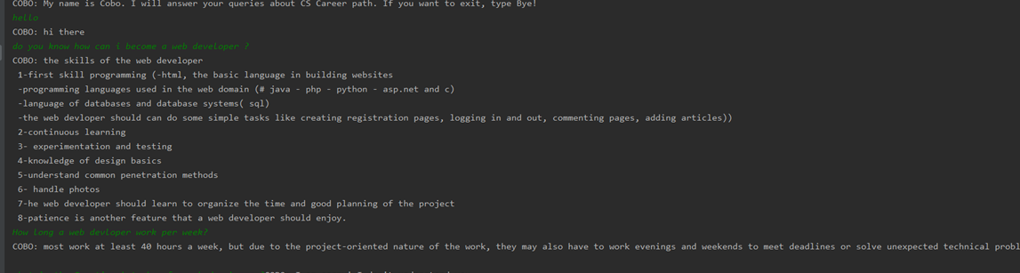
Testing and Result

Slide 10
Conclusion and future works
The developed chatbot showed a good result as it responds to the user
input correctly. Even though the chatbot didn't give a satisfied answer for
some questions, it answer other questions in a good answer. We aim to
improve it by add more paths and make it more intelligent by using other
intelligent algorithms.

Slide 11
References
[1]. wikipedia, accessed 8 November 2019,
https://en.wikipedia.org/wiki/Chatbot
[2]. Sienkiewicz Agnieszka. Oct 29, 2019 “What Is a Chatbot? 11 Benefits Of Chatbots That Will Help Your Business Grow” Accessed 8 November 2019.
https://www.tidio.com/blog/what-is-a-chatbot/
[3]. Navlani Avinash . September 4, 2018 “Text Analytics for Beginners using NLTK”
Accessed 8 November 2019.
https://www.datacamp.com/community/tutorials/text-analytics-beginners-nltk
[4]. Pandey Parul . “Building a Simple Chatbot from Scratch in Python (using NLTK) ” Accessed 14 September 2019.
https://medium.com/analytics-vidhya/building-a-simple-chatbot-in-python-using-nltk-7c8c8215ac6e

Slide 12

Thank you

